Slide 1

POC
AZURE MIGRATION
Sreedeepak Charugundla V 0.1

Slide 2
Plan of migration covering
Assessment report
Network Infrastructure
Database Migration
Server Migration
Post-migration steps

Slide 3
We are taking SmartHotel application as reference for POC
On-premises environment comprises 4 VMs hosted in Hyper-V
Database tier Hosted on the smarthotelSQL1 VM
Application tier Hosted on the smarthotelweb2 VM
Web tier Hosted on the smarthotelweb1 VM
Web proxy Hosted on the UbuntuWAF VM

Slide 4
Assessment report
Discover and assess the on-premises environment
Assessment report describe
Azure cost details
Azure Readiness
Explore dependency report

Slide 5
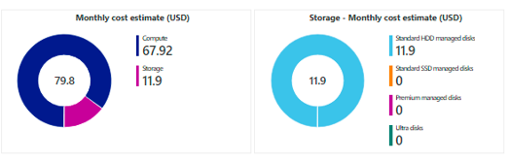
Azure Cost details
Estimated monthly cost for 3 VMs is showing below , it is further segregated in to compute cost and storage cost

Slide 6
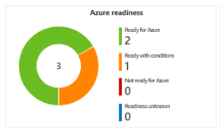
Azure Readiness
In this report it shows the Azure cloud readiness for the On-Premises (present) environment

Slide 7
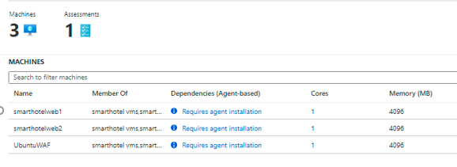
dependency report
In this report it list the dependency software/agents need to install before migration of the on-premises VM’s to Azure cloud

Slide 8
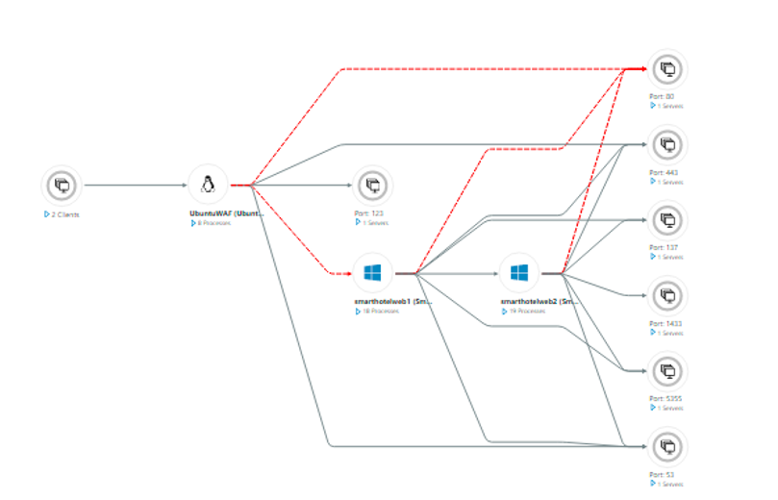

Slide 9
Network Infrastructure
Create Virtual Network
Virtual network will be used once we migrate the VMs to Azure
Migrate will only VMs Network infrastructure should be staged in advance
Create subnets for application and DB servers
Private end point for secure access of Database

Slide 10
Database Migration
Azure Data Migration Assistant
Data Migration Assessment
Assess the on-premises Database
Database Migration Service
Migrate the on-premises database

Slide 11
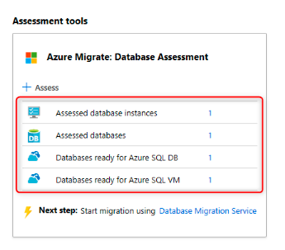
Data Migration Assessment
The DMA is integrated with Azure Migrate providing a single hub for assessment and migration tools
to assess an on-premises database for readiness to migrate to Azure SQL, and uploaded the assessment results

Slide 12
Azure Database Migration Service
Azure Database Migration Service (DMS) used for schema migration and data migration
Migrate the database schema
Migrate the on-premises database to Azure SQL database

Slide 13
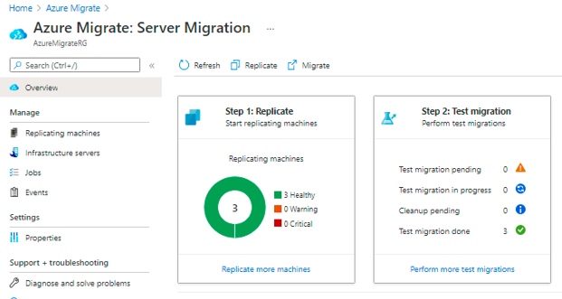
Server Migration
Server Assessment
Server Migration service
Azure Site recovery manager
Replicate the VMs
Test Migration
Migration

Slide 14
Post-migration steps
Installing the Azure VM Agent
Cleaning up migration resources
Enabling backup and disaster recovery
Encrypting VM disks
Ensuring the network is properly secured
Ensuring proper subscription governance is in place, such as role-based access control and Azure Policy
Reviewing recommendations from Azure Advisor and Security Center

Slide 15
Thank You

